Slide 1
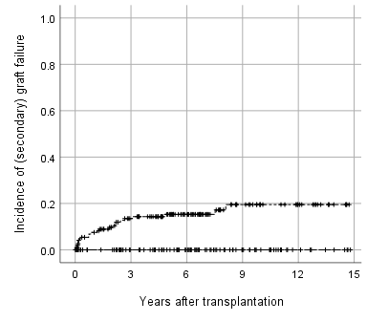
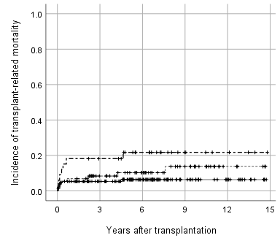
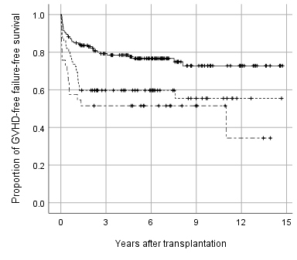
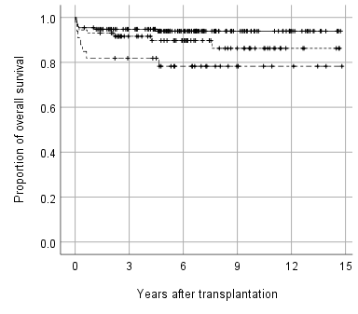
(A)
(B)
MSD
WM-URD
PM-URD
MSD
WM-URD
PM-URD
P < 0.01
P = 0.03
(C)
(D)
P < 0.01
P = 0.02
MSD
WM-URD
PM-URD
MSD
WM-URD
PM-URD

Slide 2
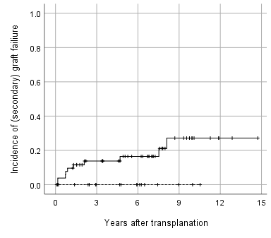
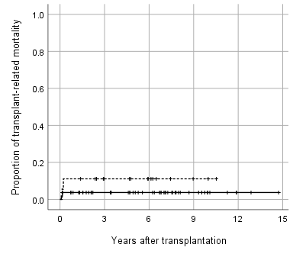
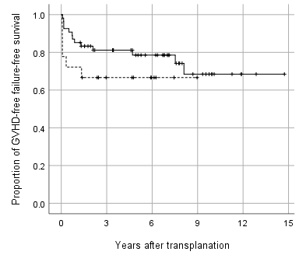
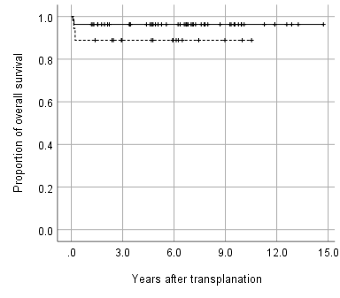
(A)
(B)
MSD
URD
MSD
URD
P = 0.06
P = 0.25
(C)
(D)
P = 0.24
P = 0.21
MSD
URD
MSD
WM-URD

